Slide 1
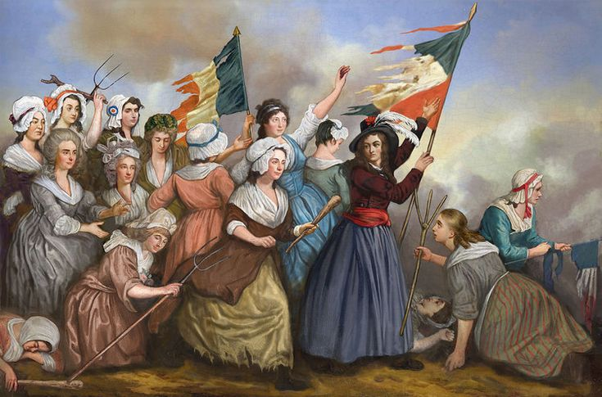
Women And the French revolution
Pragya Singh (2020CE10270)
Rishika Arya (2021MT10926)

Slide 2
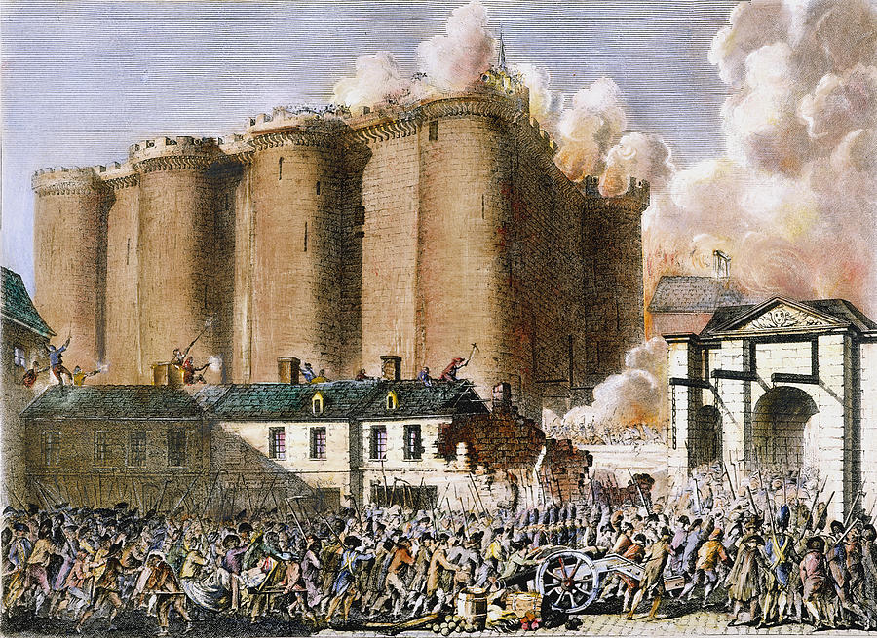
Introduction to french revolution(1789-99) “French Revolution was a political upheaval against ancient regime, characterized by absolutism , system of privileges and burden of taxation on commoners.”
The French Revolution of 1789 was a significant historical event that marked the beginning of modern France and the end of the Ancient Régime. It was a time of political, social, and cultural change, and women played an essential role in the events leading up to and during the revolution.

Slide 3
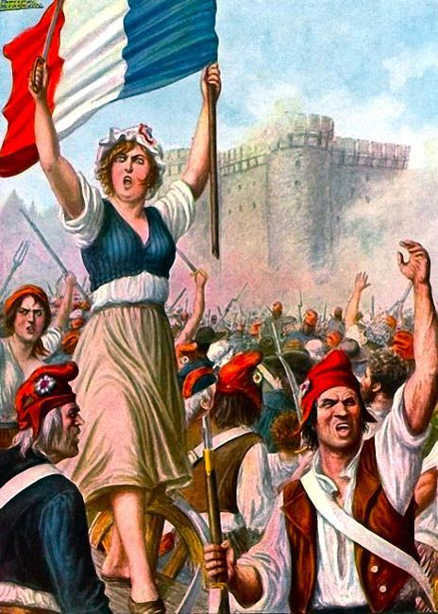
Women's march on versailles
The French Revolution began with thousands of women unhappy over the price and scarcity of bread. These women grew into some 60,000 marchers two days later. The march turned the tide against the royal rule in the France, forcing the king to submit to the people's will and proving that the royals were not invulnerable.

Slide 4
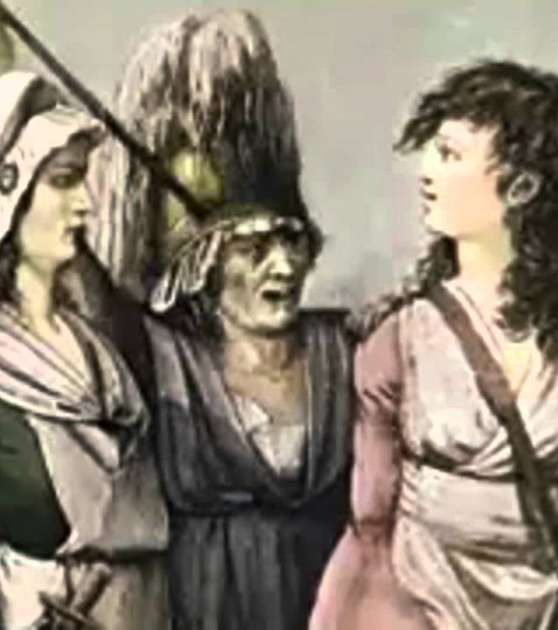
Why revolution among women?
Economic hardship: Women, particularly those from the lower classes and household women, were heavily impacted by the economic crisis that plagued France in the 18th century.
Political exclusion: Women were excluded from political participation and had no representation in the government. This led to frustration and resentment among women who saw the revolution as an opportunity to demand political rights.

Slide 5
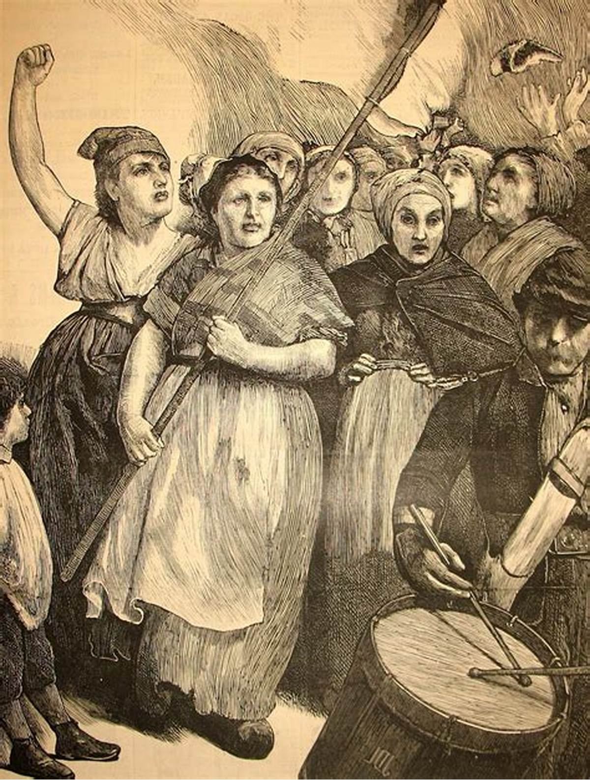
Why revolution among women?
Enlightenment ideas: The Enlightenment profoundly impacted French society, including women. They were inspired by the ideas of liberty, equality, and fraternity at the heart of the revolution. They began to question their social and political roles and demanded equal rights and opportunities.
Role in the family: The French Revolution's rhetoric of equality inspired some women to claim their place in the family and push for a more significant role in their children's education.

Slide 6
The women's revolution: A powerful force in the french revolution

Slide 7
Women's participation in pre-revolutionary France:
Women in pre-revolutionary France, which refers to the period before the French Revolution of 1789, faced significant challenges and limitations in terms of their social and legal status.
Socially,
women were often confined to the domestic sphere.
They had limited access to education and employment opportunities.

Slide 8
Women's participation in pre-revolutionary france
Legally,
women had limited rights and were not recognized as full citizens.
They could not vote or hold public office, and their ability to own property was restricted.
Women's legal status was often tied to their marital status.

Slide 9
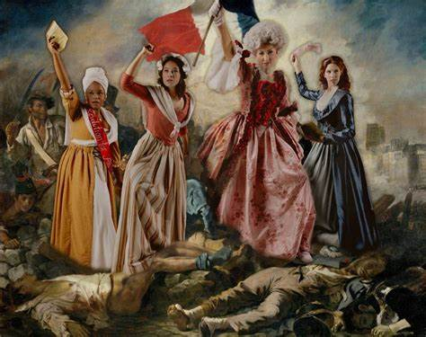
Women's participation in pre-revolutionary france
Despite these limitations, some women were able to make significant contributions to French society. Women from wealthy families were able to use their wealth and social status. However, majority of women remained marginalized and disenfranchised in pre-revolutionary France.

Slide 10
DEMANDS OF WOMEN IN THE FRENCH REVOLUTION
POLITICAL RIGHTS:
Women demanded the right to participate in the political process, including the right to vote, run for office, and be represented in the government.
They argued that they should have the same political rights as men.

Slide 11
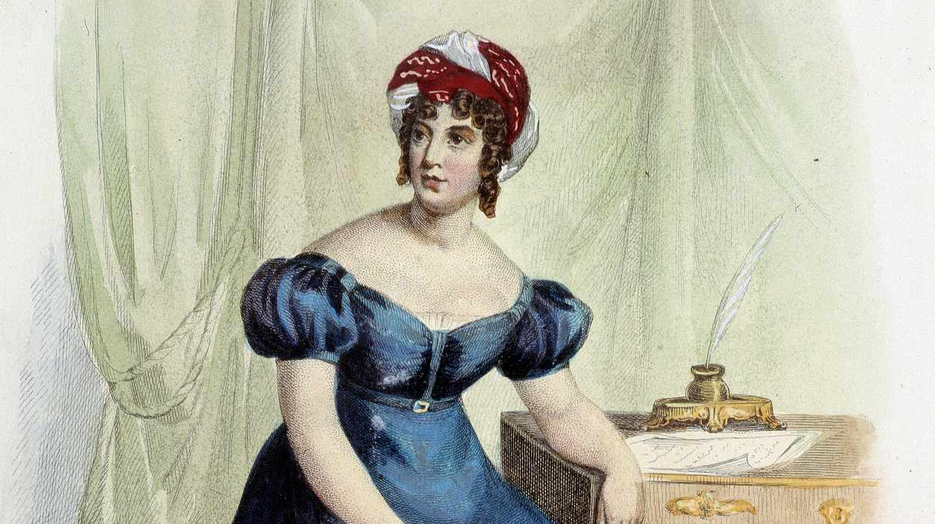
Demands of women in the french revolution
EDUCATIONAL RIGHTS:
Women demanded access to education, particularly in areas such as reading, writing, and arithmetic. They believed that education would enable them to be better citizens and participate more fully in society.

Slide 12
Demands of women in the french revolution
ECONOMIC RIGHTS:
Women demanded the right to work and earn wages equal to men.
They also advocated for the abolition of laws that restricted their economic activities

Slide 13
DEMANDS OF WOMEN IN THE FRENCH REVOLUTION
LEGAL RIGHTS:
Women demanded equal legal rights, including the right to own property, the right to divorce, and the right to have custody of their children.
They argued that these rights were necessary to ensure their independence and autonomy

Slide 14
DEMANDS OF WOMEN IN THE FRENCH REVOLUTION
SOCIAL RIGHTS:
Women demanded an end to the social and cultural restrictions that prevented them from fully participating in society.
They wanted to be able to participate in public life and to be recognized as equal members of society.

Slide 15
The emergence of women's activism during the french revolution
women began to demand their rights as citizens and equal participants in the revolutionary process.
prominent example of women's activism during the French Revolution was the Women's March on Versailles in October 1789.
the formation of political clubs, such as the Society of Revolutionary Republican Women (1793).
Individual women also played significant roles in the French Revolution. For example, Olympe de Gouges.

Slide 16
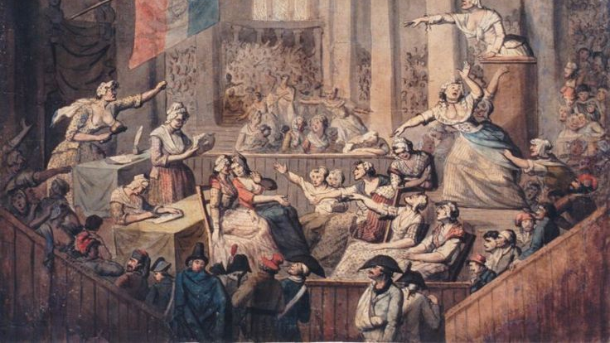
Women's political club and societies

Slide 17
Women's political club and societies
Provided women with a platform to voice their opinions and advocate for their rights.
Society of Revolutionary Republican Women (1793): This group was led by prominent figures such as Pauline Leon and Claire Lacombe and advocated for women's rights, including the right to vote and to participate in politics.

Slide 18
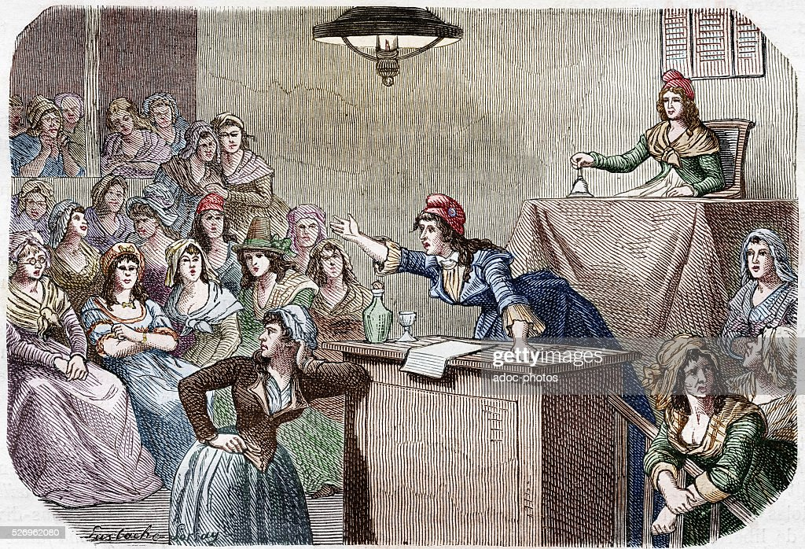
Women's political club and societies
Society of Revolutionary Republican Citoyennes (1790): focused on education and social welfare.
Society of Friends of Truth (1791): supported women's participation in politics and the arts.

Slide 19
Women's political club and societies
Women's political clubs faced significant opposition from both the government and other revolutionary groups.
Many of these clubs eventually shut down, and women's political participation was severely restricted.
These clubs and societies laid the groundwork for future feminist movements and continued to inspire women throughout the world to fight for their rights and political representation.

Slide 20
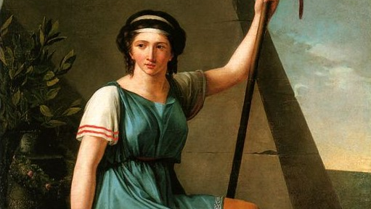
SOME IMPORTANT WOMEN FIGURES OF FRENCH REVOLUTION

Slide 21
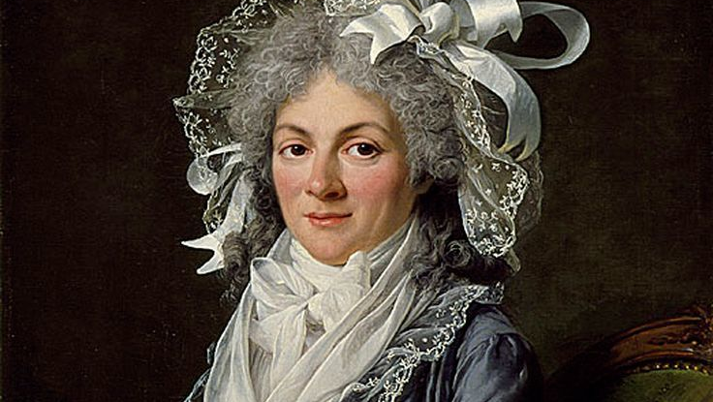
Olympe de gouges
Olympe de Gouges, a playwright in France before the Revolution, sought to remedy the exclusion of women. In 1791, she wrote and published the "Declaration of the Rights of Woman and of the Citizen” .
The document was modeled after the Assembly’s document, asserting that women, while different from men, also had the capacity of reason and moral decision-making. She asserted that women had the right to free speech.
De Gouges was associated with the Girondists and fell victim to the Jacobins and the guillotine in November 1793.

Slide 22
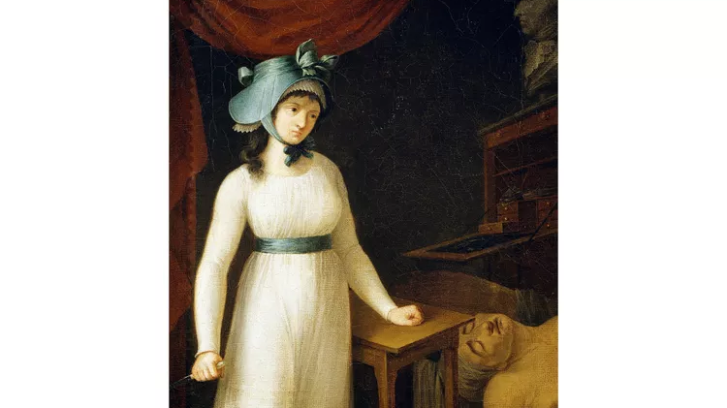
Charlotte Corday
Charlotte Corday supported the Revolution and the more moderate Republican party, the Girondists, once the conflict was underway. When the more radical Jacobins turned on the Girondists, Corday decided to murder Jean-Paul Marat, the journalist who called for the death of the Girondists. She stabbed him in his bathtub on July 13, 1793, and was guillotined for the crime four days later after a quick trial and conviction

Slide 23
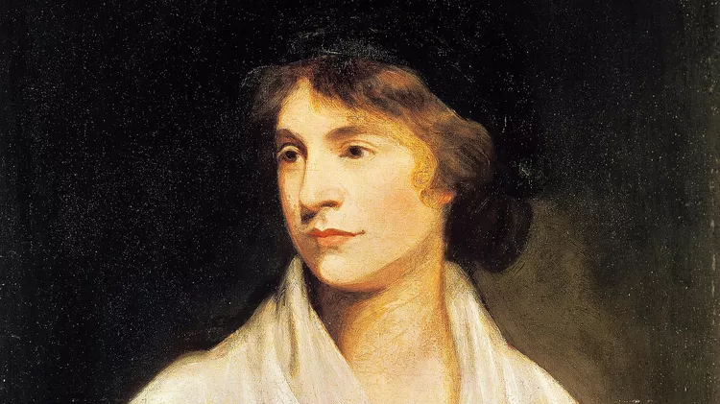
Mary Wollstonecraft
Mary Wollstonecraft may have been a British writer and citizen, but the French Revolution influenced her work. She wrote the books "A Vindication of the Rights of Woman" (1792) and an "A Vindication of the Rights of Man" (1790) after listening to discussions in intellectual circles about the French Revolution. She visited France in 1792 and published "A Historical and Moral View of the Origin and Progress of the French Revolution." In this text, she tried to reconcile her support for the basic ideas of the Revolution with her horror at the bloody turn it took later.

Slide 24
Achievements
Some of the achievements for women during the French Revolution include:
The right to education: During the Revolution, schools were opened to girls, and they were allowed to receive education.
The right to own property: Women were granted the right to own property in their own name, which was a significant achievement as previously, women's property belonged to their husbands.
The right to divorce: Women were given the right to divorce their husbands and were no longer bound by an unhappy or abusive marriage.

Slide 25
Achievements
4.The right to participate in politics: Women were allowed to participate in political clubs and were able to express their views on the issues of the day.
The right to equality before the law: The revolutionaries declared that all citizens were equal before the law, which included women.
The right to work: Women were allowed to work in industries previously closed to them, such as printing and publishing.
While these achievements were significant, it is important to note that they were not extended to all women, as they were mostly restricted to the upper classes. Nonetheless, the French Revolution marked an important turning point in the history of women's rights and paved the way for further progress towards gender equality.

Slide 26
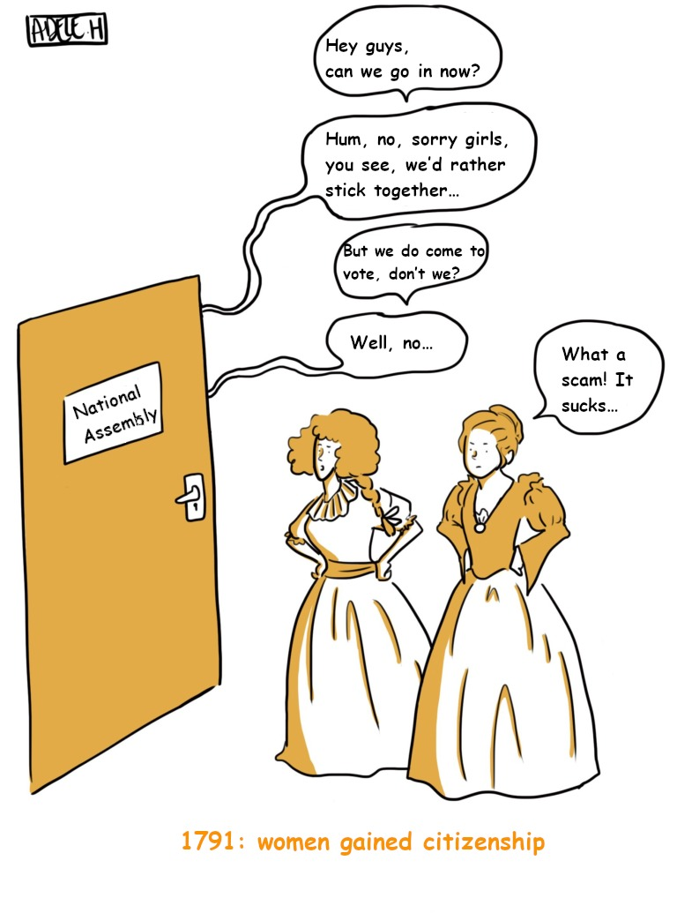

Slide 27

How it influences French Society
Prior and during the French Revolution, women made a lot of efforts to change their status in society. During these years their contribution was important and crucial. Although their attempts didn’t have the results women wanted, their contribution in the French Revolution and their constant demand for political rights was a turning point in the history.

Slide 28
Why women was not able to get their rights
Women have never operated as one monolithic group, and the French Revolution proved no exception.
If the movement had ever been unified, that unity dissolved quickly. There is some fluidity between these groups, but in general the upper class had very little to do with the street worker. And even among the working class women, there were ideological differences between the more radical republicans revolutionaries such as Pauline Leon, and the ordinary market women who did not relate to their political fervor.
These women did not always agree on what was important, and the men in power exploited the disagreements to shut down the more radical protests.
These divisions among women were mirrored in the movement at large, and the debate in France over true liberté continued to play out in cycles of revolution and counter-revolution.

Slide 29
impact on women
Although women had not gained the right to vote or hold office, they had certainly made their presence known during the Revolution. At the end of the decade of revolution, a well-known writer, Constance Pipelet, offered her views on its impact on women.
She did insist that the Revolution had forced women to become more aware of their status in society.
She also argued that the Republic should justify itself by offering women more education and more opportunities. Her writing shows that women's demands had been heard and that even if they had gone underground, they had not been forgotten.

Slide 30
Women through the Lenses of French Men

Slide 31
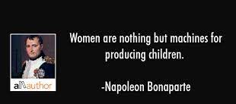

Slide 32
Depiction in Paintings
Art in the Neoclassic era, especially in France, was greatly influenced by the French Revolution.
Since men were mainly the only ones fashioning paintings at this time, the way women were depicted in art was a direct reflection of men’s lenses and what they deemed worthy or unworthy in women’s behaviors in light of the French Revolution.
At that time, revolutionaries abated women involved in politics, but praised ladies that would diligently take care of their houses and children.
The theme of motherhood is presented iconographically as a symbol of reformed manners and family life in the new political order. Many instances of mothers are found in revolutionary prints, typically nursing babies and minding children.
.

Slide 33
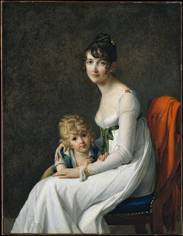
Madame Philippe Panon Desbassayns de Richemont and Her Son, Eugene, Marie Guillelmine Benoist, Oil on Canvas, 1802, 53.61.4
In the immediate years following the French Revolution, women involved with domestic affairs continued to be praised. In this painting, the mother, Madame Philippe Panon, holds her son, Eugene, very closely and with love. This portrait is meant to encourage other mothers to do the same in loving and caring for their homes. This idea that women should stay at home is furthered by Jean-Jacques Rousseau, who believes that women are incapable of invention and should not be involved in public spheres, which, he was confident, were reserved for men only.

Slide 34
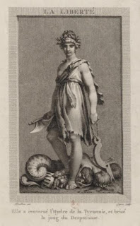
Liberty—She Has Overthrown the Hydra of Tyranny and Broken the Yoke of Despotism, Pierre Paul Prud’hon and Jacques-Louis Copia, Engraving, 1793, Bibliotheque Nationale de France
The female body is used as an allegory for Liberty. The void female body made it propitious for male culture to use the female figure as a representation for basically anything.
An insight as to why women were chosen by didactic artist to represent the ideals of Enlightenment is correlated with the levels of participation women were allowed in political circles
Revolutionaries who really clinged to traditionalist gender roles were able to publically utilize female bodies as an excuse for excluding them from the public affairs.
Unlike the representation of men in artwork, which was tied to Greco-Roman ideals of beauty, women were essentially blank slates of the average civilian.

Slide 35
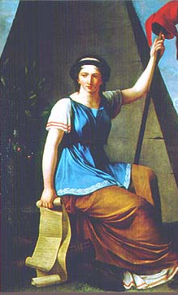
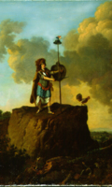
The most popular figure was Liberty, who became, in effect, the preferred symbol of the French Revolution. Liberty nonetheless became indelibly associated with the French Revolution, so much so that she still appears prominently on French money and in patriotic paintings and statuary.
Liberty usually appeared in Roman dress, often in a toga, holding a pike, the people's instrument for taking back their liberty, with a red liberty cap perched on its tip.

Slide 36
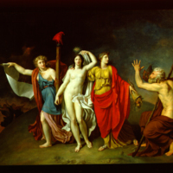
Truth
Liberty was often joined by another revolutionary virtue such as truth, as in the painting Allegory of Truth by Nicolas de Courteille. After the Republic was proclaimed in September 1792, depictions of the Republic as a female allegorical figure sometimes took over from Liberty. Liberty, Reason, Regeneration—as in this engraving of the Festival of Reunion of 10 August 1793 —Wisdom, and of course Equality and Fraternity, were all represented as women. These allegorical figures sprouted on every surface

Slide 37
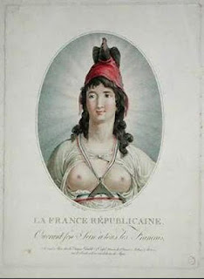
Republican France offering Her Breasts to All Frenchmen, Boizot
This image sets a link between the use of the female figure as an allegory for Enlightenment Ideals, in this case, the Republic, and the idealization of women as republican mothers. When the women in the picture is “offering her breasts to all Frenchmen,” that alludes to the idea of nursing and nurturing, which is characteristic of a faithful mother. Another aspect present with the offering to “all Frenchmen” is tied to the idea of equality and how all men deserve, to the same extent, to be involved in the republic and the political French environment.

Slide 38
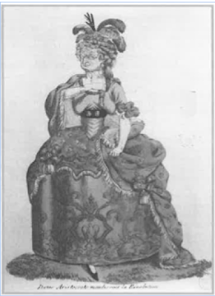
Aristocratic Lady Cursing the Revolution, Unknown, Engraving, 1789, Musee Carnavalet
During Revolutionary France, artists made use of female grotesques to represent evil. An example of such is this engraving. It establishes a link between political and sexual liberty: it depicts women involved in political circles as foolish women who have an excess of unpleasant sexuality as shown by her shaggy breasts and less than charming face. Many artists would depict their grotesques based on Marie Antoinette, who was very vocal about her political views, even more than her husband, the king. Her rambunctious nature made the king look publically weak and was mocked by the men who thought women should have nothing to do with politics.

Slide 39
How women's during French revolution impacted other parts of the world?

Slide 40
Impact on other parts of world
The women of the French Revolution inspired women's movements and activism not only in France but also in other parts of the world, including:
Europe: The French Revolution sparked a conversation about gender equality and women's rights that spread to other European countries.
Women in England, for example, were influenced by the French Revolution and formed their own organizations to advocate for women's rights, such as the Ladies of Langham Place and the Women's Social and Political Union.

Slide 41
Impact on other parts of world
North America: The French Revolution also had an impact on the women's suffrage movement in North America.
The Seneca Falls Convention, which is often considered the beginning of the women's suffrage movement in the United States, was inspired by the French Declaration of the Rights of Man and Citizen.
Latin America: Women in Latin America were also influenced by the French Revolution and its ideas about equality and democracy. Women in countries such as Mexico, Argentina, and Chile began to advocate for their own rights, such as the right to vote and the right to education.

Slide 42
Impact on other parts of world
Middle East: In the late 19th and early 20th centuries, women's movements began to emerge in the Middle East that were inspired by the French Revolution and its ideas about democracy and human rights
Women in countries such as Egypt, Iran, and Turkey began to advocate for their own rights, such as the right to education and the right to vote.
Overall, the women of the French Revolution played an important role in inspiring women's movements and activism across the world, and their ideas about gender equality and democracy continue to influence and inspire women today.

Slide 43
Conclusion
Prior to the French Revolution, women generally did not have many rights. There was an expectation set upon them to be obedient and take care of their families, and this ideology was rarely challenged.
With political tensions high and a society fighting for the state of their nation, women were able to also find their own empowerment.
These women ultimately paved the way for future fighters to fight for equality between the sexes and helped to liberate the women of France in the 18th century, playing a crucial role in the shaping of France’s treatment of women.
They were ultimately able to achieve liberation for women during the French Revolution through their involvement in the bread riots and their striving for political independence.

Slide 44
While progress has been made, there is still much work to be done to achieve full gender equality. Women continue to face discrimination and unequal treatment in various areas of life, including the workplace, politics, and education. However, the progress made since the French Revolution serves as a reminder of the power of collective action and the importance of ongoing advocacy for women's rights.

Slide 45
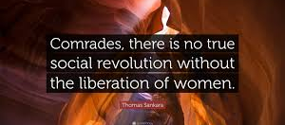

Slide 46
Terminologies used in the slide
GIRONDISTS (or GIRONDIN): Girondin, also called Brissotin, a label applied to a loose grouping of republican politicians, who played a leading role in the Legislative Assembly from October 1791 to September 1792 during the French Revolution.
JACOBINS: The Jacobins were members of an influential political club during the French Revolution. They were radical revolutionaries who plotted the downfall of the king and the rise of the French Republic
GUILLOTINE: A guillotine is an apparatus designed for efficiently carrying out executions by beheading.

Slide 47
references
ojsadmin,+Footnotes+13+V1b-76-84.pdf
https://revolution.chnm.org/exhibits/show/liberty--equality--fraternity/women-and-the-revolution
https://www.thoughtco.com/women-and-the-french-revolution-3529110
https://blogs.loc.gov/international-collections/2020/07/women-in-the-french-revolution-from-the-salons-to-the-streets/
https://www.ukessays.com/essays/history/women-in-french-revolution-acceptance-and-denial-history-essay.php
French Revolution for Kids: Jacobins (ducksters.com)

Slide 48
THANK YOU

